Slide 1




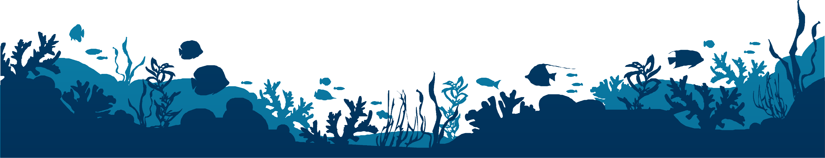

MINISTRY: Indian National Centre for Ocean Information Services (INCOIS), Ministry of Earth Sciences (MoES)
TEAM: KALASHNIKOV
LEADER: C.BIBIN

Slide 2


6
INTENTION
Our motto is to provide a dedicated software for the fishermen for finding the fishing hotspots for free of cost
The aim of this study is to assess the uptake of Satellite data in the fishing fleet and the feasibility of producing a map of fishing hotspot with high spatial and temporal resolution.

Slide 3




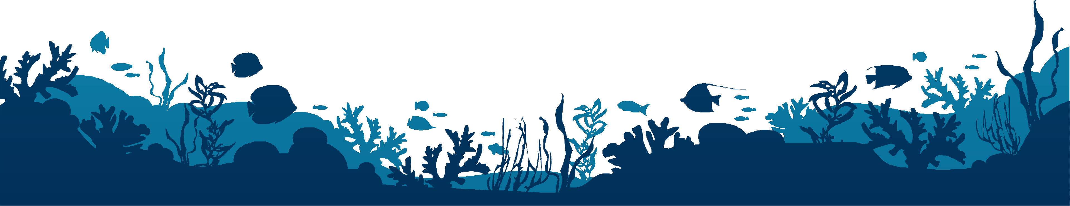
28
INFORMATION GATHERED
1
On the basis of our problem statement, our team had spoken to different fishermen. They had mentioned some of the hardships faced during fishing, which were related to the problems that are faced by them. Our team had taken account of their problem and mentioned it here for reference.
3
5
4
6

Slide 4

PROBLEM
3
They suffer a lot in the worst climatic conditions like storms and cyclones during their journey. Also it is difficult to track them when they are in trouble.
Fishery activities are not properly monitored and regulated. Also, fishermen don't have proper reporting systems for analysis of fishery activities.
Fishermen were unable to locate these fishing hotspots in the ocean. So we provide a mechanism for finding those fishing hotspots in the sea,thereby making their fishing more productive.

Slide 5
28
SOLUTION
So we are providing them an application called FISH-HUB which provides the weather status, fishing hotspots, in an interactive manner.
We provide the wind speed (after five days from the present day) at sea. This will alert or intimate the fishermen about the weather conditions. If the weather is worse, the fishing hotspots won't be revealed, thereby providing a safer journey.
We created a database for monitoring fishing activities, and it will be managed by the app administrators. We will get the location where the fishermen fish and the NOAA information for the dataset.
1
3
5
4
6

Slide 6
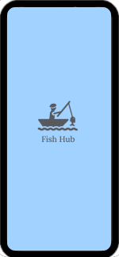
28
IMPLEMENTATION IDEA
Our team fixed this issue by providing fishing hotspots.
The fishing hotspots are found using the statistics provided by open sources from NASA data repositories. We use 3 datasets, namely chlorophyll , sea surface temperature and the contamination levels in the sea.
We can get the logic of how much range those dataset values should have in order to find the fishing hotspots using machine learning.
In machine learning, we use neural network algorithms to find the statistics for fishing hotspots.
1
3
5
4
6

Slide 7
28
REFERENCE
DATASET REFERENCES:
1.https://polarwatch.noaa.gov
2.https://earth.nullschool.net/#current/particulates/surface/level/overlay=pm2.5/orthographic=-279.57,9.31,717/loc=81.385,12.708
3.https://neo.gsfc.nasa.gov/dataset_index.php#ocean
4.https://polarwatch.noaa.gov/catalog/chl-aqua/download/?dataset=monthly&var=chlorophyll&time_min=2022-05-16T00:00:00Z&time_stride=1&time_max=2022-05-16T00:00:00Z&y_min=-89.97917&y_stride=1&y_max=89.97916&x_min=-179.9792&x_stride=1&x_max=179.9792&fmt=nc
1
3
5
DOCUMENTATION REFERENCE:
1.https://www.e3s-conferences.org/articles/e3sconf/pdf/2022/06/e3sconf_10icmr-2insaef2022_02002.pdf
4
6

